Slide 1


QCHS2022: The Yao ecosystem
Xiu-Zhe (Roger) Luo
University of Waterloo/Perimeter Institute/PIQuIL
中国科学院物理研究所
Institute of Physics, CAS
中国科学院理论物理研究所
Institute of Theoretical Physics, CAS
University of Waterloo
Unitary Fund

Slide 2
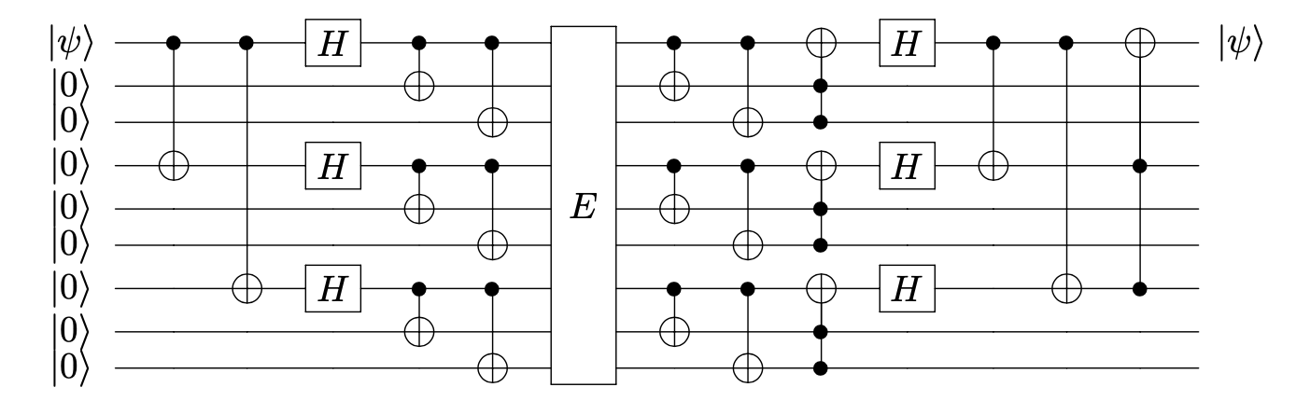
Quantum Computing
A Quantum Circuit

Slide 4

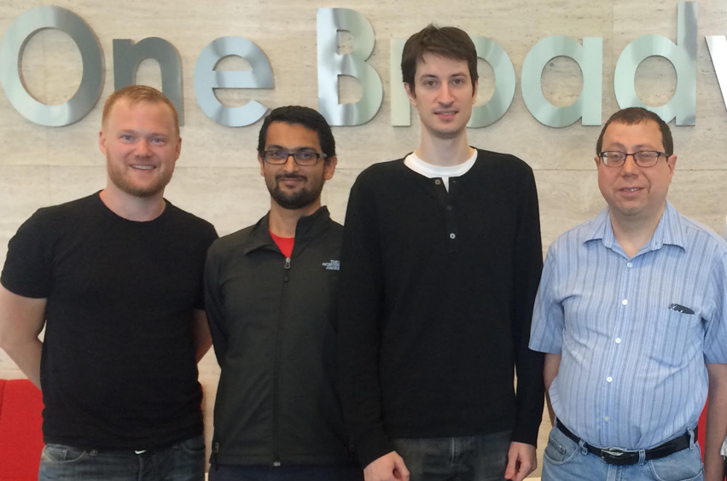
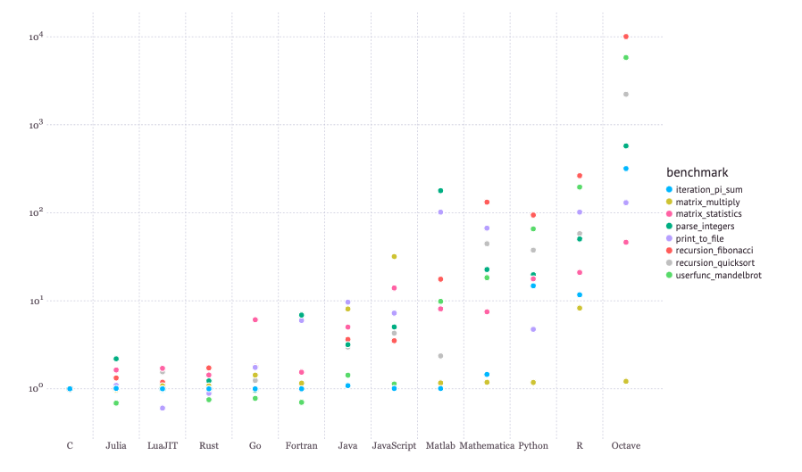
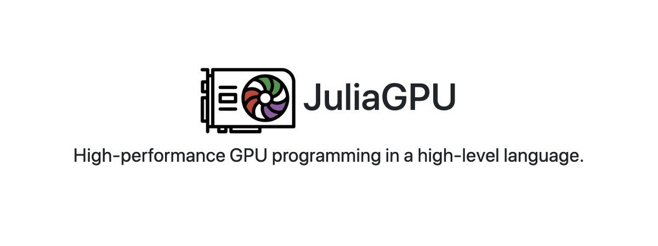




The programming language
julialang.org
Jeff Bezanson, Stefan Karpinski, Viral B. Shah, Alan Edelman
Fast
Generic
Differentiable
quantum programming
DualNumber, FixedPointNumber,
Symbolic Number, Tropical Number…
Julia: A Fresh Approach to Numerical Computing. Jeff Bezanson, Alan Edelman, Stefan Karpinski, Viral B. Shah. (2017) SIAM Review, 59: 65–98.

Slide 5
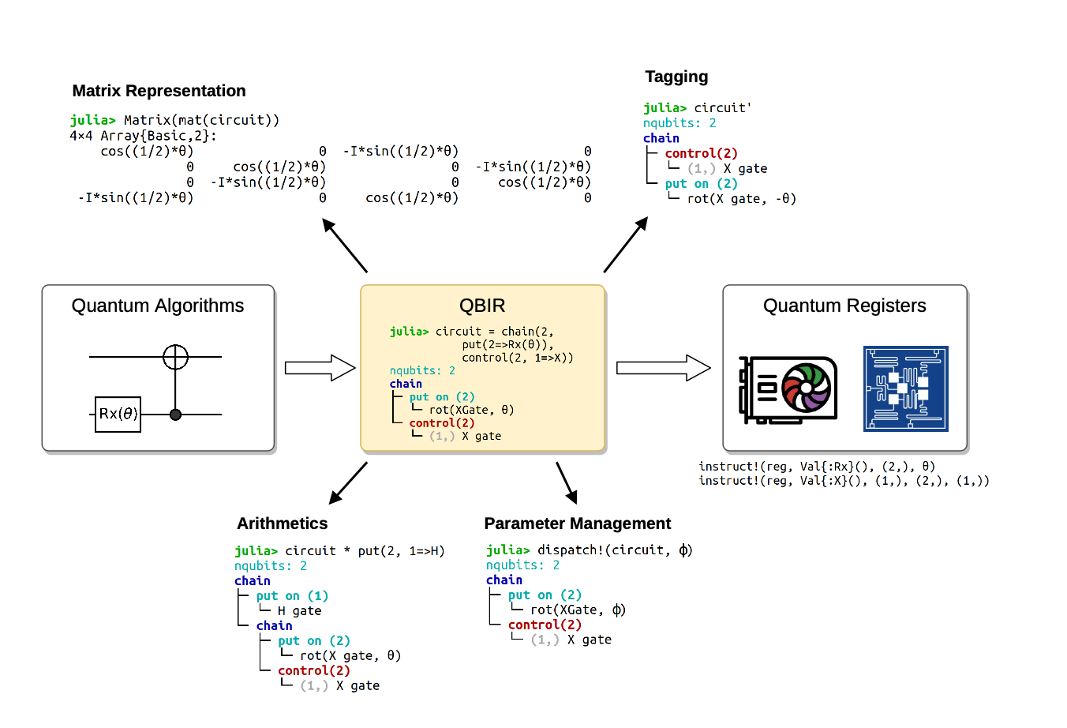
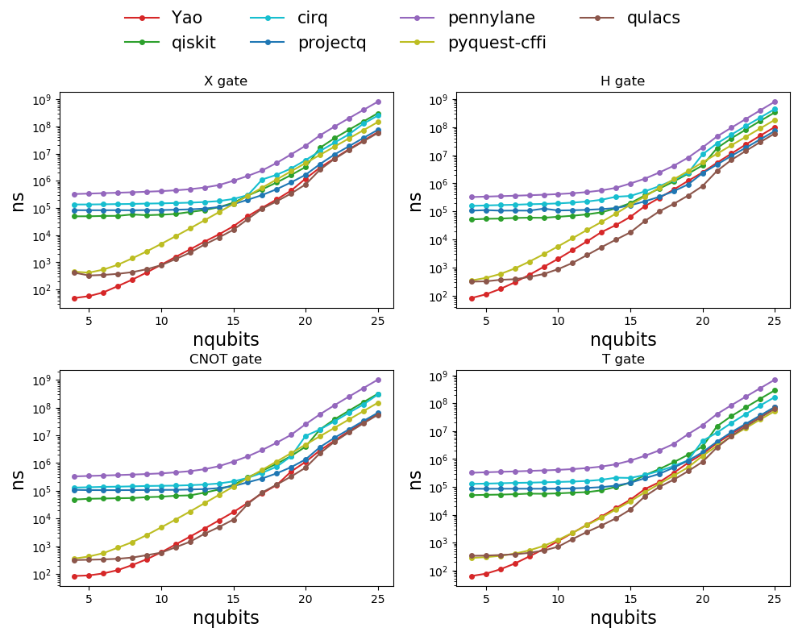
The Yao project: stable release (2020)
Top performance circuit emulation
Luo, X., Liu, J., Pan, Z., & Wang, L. (2020). Yao.jl: Extensible, Efficient Framework for Quantum Algorithm Design. Quantum

Slide 6
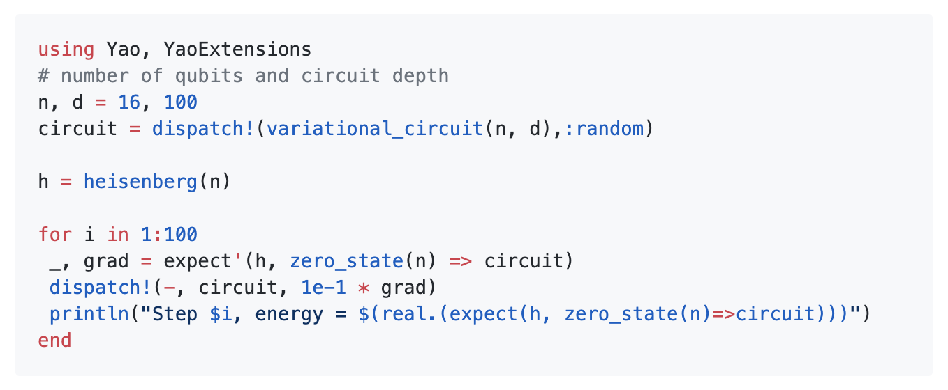
Built-in AD engine

Slide 7

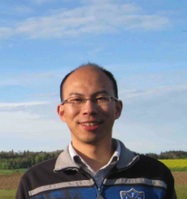

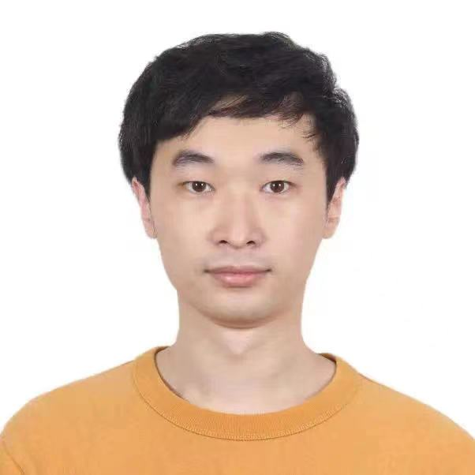
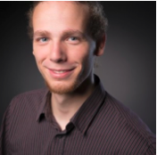



The team
Me
University of Waterloo & Perimeter Institute
Jinguo Liu
Harvard University
Lei Wang
Institute of Physics, CAS
Pan Zhang
Institute of Theoretical Physics, CAS
Chen Zhao
Institute of Math, CAS
Valentin Churay
Julia Lab, MIT
William Moses
MIT
Taine Zhao
University of Tsukuba
Chetan Vardhan
IIT

Slide 8
The ecosystem of Yao.jl
The projects has been working on

Slide 9
QuAlgorithmZoo: A curated implementation of quantum algorithms with Yao.jl
Variational Quantum Eigensolver
Quantum SVD
Imaginary Time Evolution Quantum Eigensolver
HHL algorithm
QAOA
Quantum Circuit Born Machine
QuGAN
Shor
Grover search
….

Slide 10
YaoCompiler: unleash Julia on quantum devices
Pipeline 1 (Done)
Pipeline 2 (WIP)
Simplification
Static Single Assignment (SSA) IR based simplification Hybrid, DONE
Quantum Block IR based simplification Quantum, Exact, WIP
ZX diagram-based simplification Quantum, Heuristic, DONE
Quon diagram-based simplification Quantum, Heuristic, WIP
Related Implementation: YaoCompiler, ZXCalculus, etc.
OpenQASM v2
Julia
Yao IR (SSA)
IBM Q
AWS Braket
OpenQASM v2
OpenQASM v3
Julia
Yao IR (SSA)
MLIR Yao dialect
Pulse Generator

Slide 11
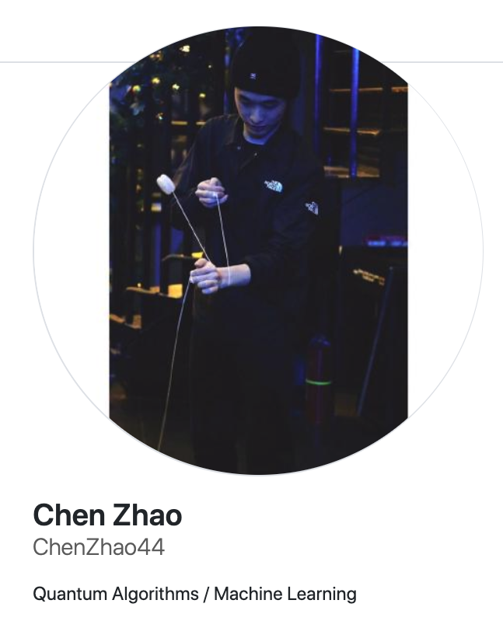
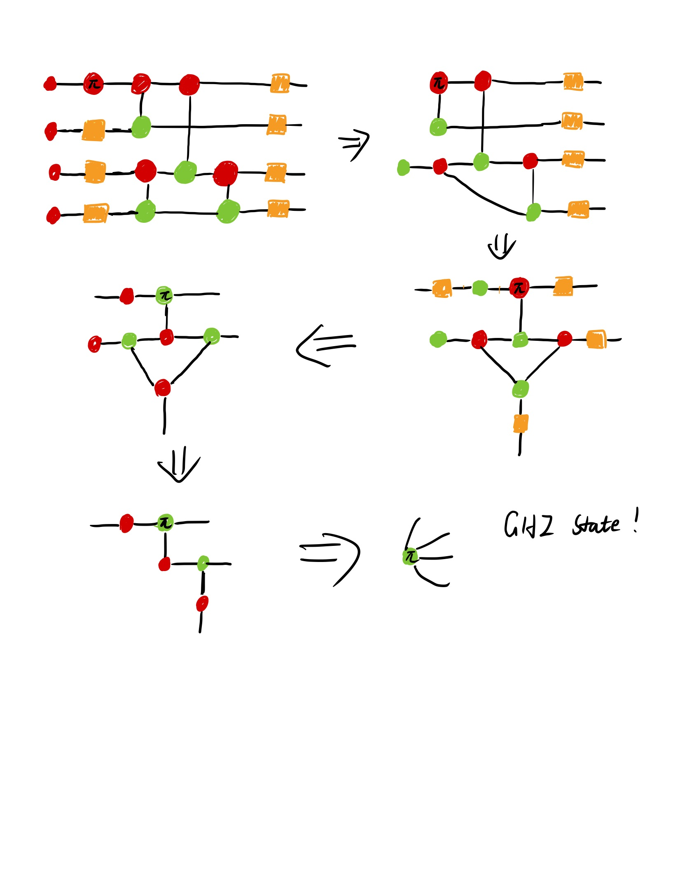
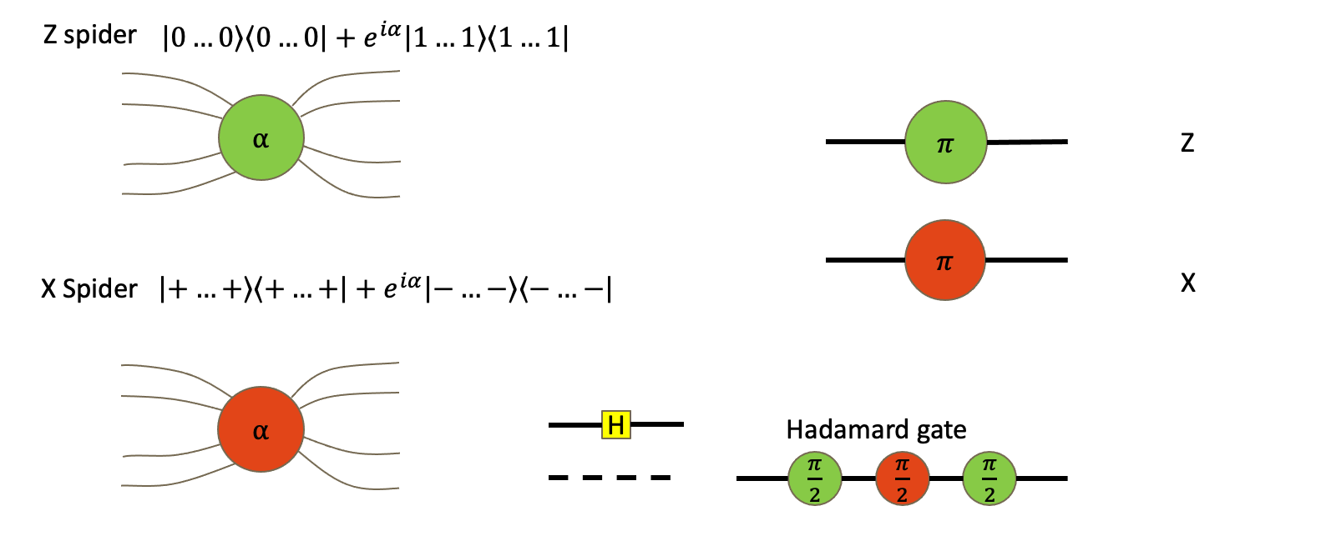
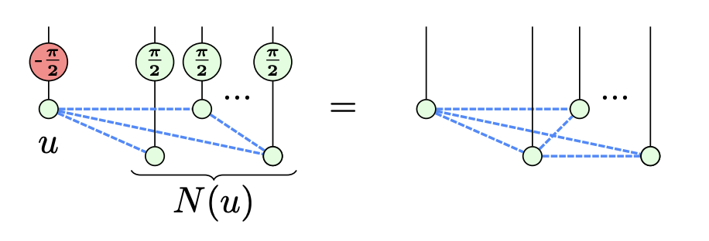
ZX calculus: graphical language for quantum circuits
local complement of graph state
arxiv 1902.03178
https://github.com/QuantumBFS/ZXCalculus.jl

Slide 12
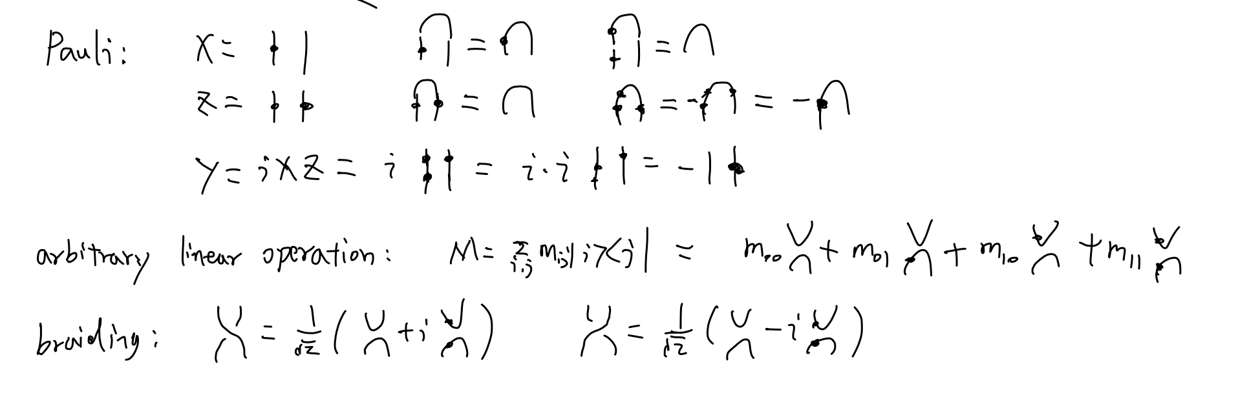
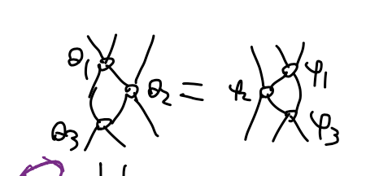
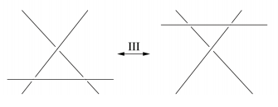
Quon: topological language for quantum information
Hard to eval numerically!!
Yang-Baxter Equation
Yang-Baxter Equation is the Reidemeister move in knot theory
10.1073/pnas.1621345114
https://github.com/QuantumBFS/Quon.jl

Slide 13
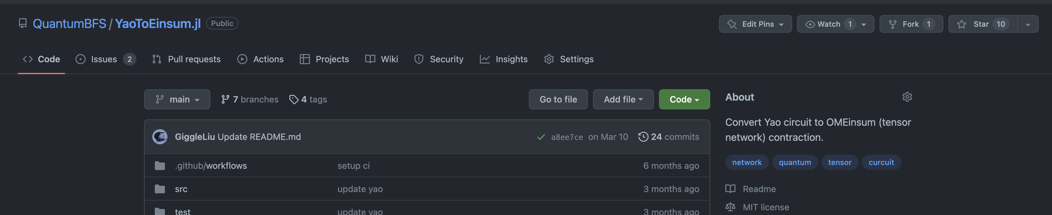
YaoToEinsum: Tensor network-based circuit simulation

Slide 14
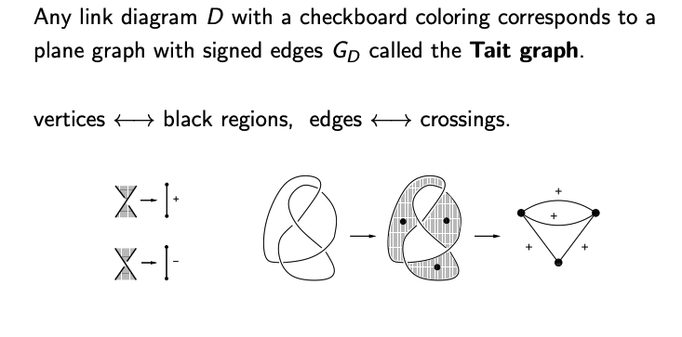
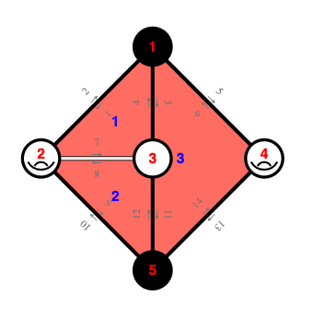
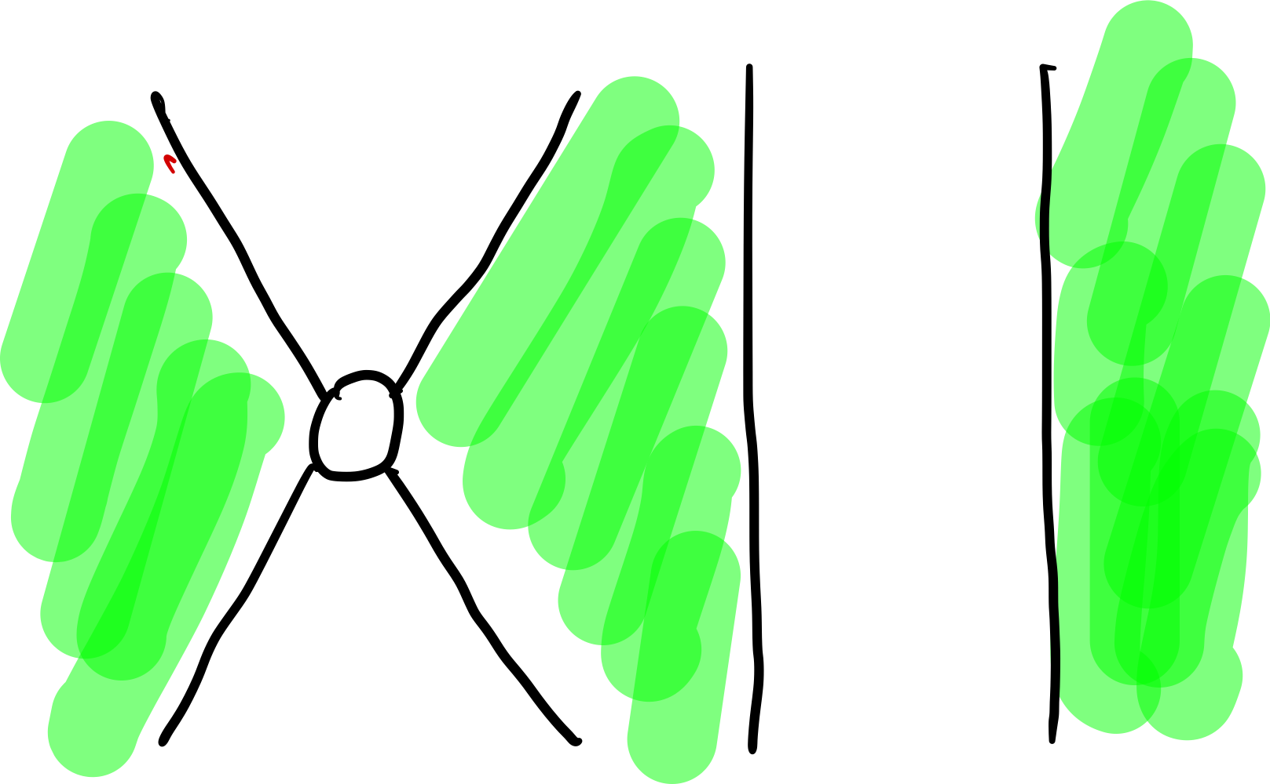
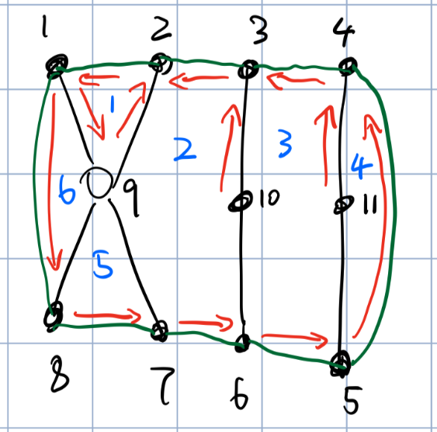
Evaluate Quon numerically
Tait Graph of the string-knot diagram
Extended tait graph for Quon
Knots, graphs and Khovanov homology I, Abhijit Champanerkar, 2013
The Rz Gate in extended Tait graph
The Rz Gate in string-knot diagram with coloring
Representing the Planar Graph of Quon
No previous numerical data structure found; thus, we designed our own
Inspired by the mesh representation from computational graphics,
We invent our own data structure for Quon that stores the following mappings
Vertices to half edge
Half edge to face
Half edge A and its next half edge B on a face
Twin: Half edge A and its neighbor half edge on opposite direction A’
* Guarantee O(1) or O(n) query complexity for our rewrite algorithm

Slide 15
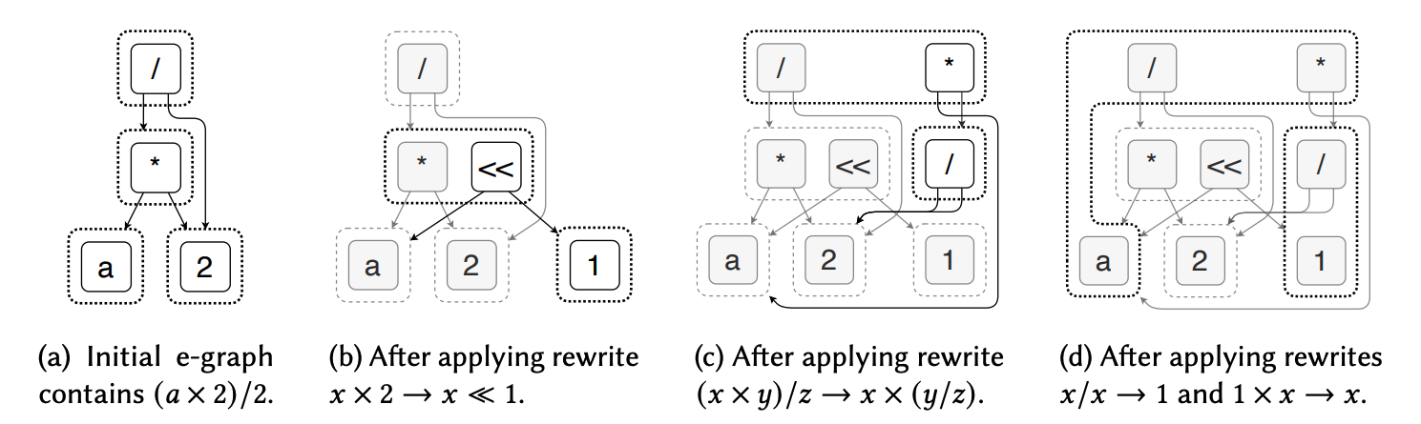
Exact template matching via EGraph
Properties
Brute force match algorithm (non-poly)
Non-heuristic, always simplifies program
Can be extended for pulse (general operators)
The QBIR in our previous work naturally fits egraph
Demonstration of egraph based rewrite process
Yao.jl: Extensible, Efficient Framework for Quantum Algorithm Design, Xiu-Zhe Luo, et al
egg: Fast and Extensible Equality Saturation arXiv: 2004.03082
Metatheory.jl: Fast and Elegant Algebraic Computation in Julia with Extensible Equality Saturation 10.21105/joss.03078

Slide 16
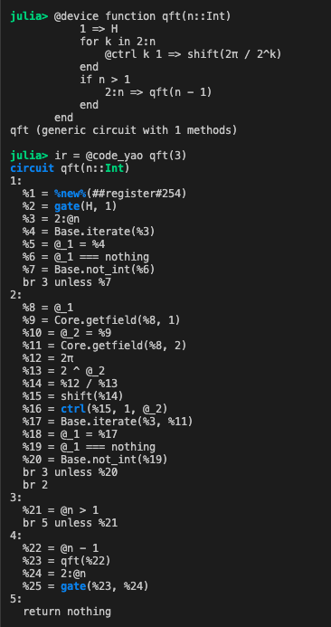
Hybrid program
SSA IR
Variables are only assigned statically for once
Traditional industrial compiler IR (LLVM, GCC, etc.)
Better ecosystem, more targets (ARM, x86, FPGA etc.)
Easy to analysis/optimize
Extending SSA form IR for hybrid quantum program
Quantum block + quantum terminator
Partially evaluate quantum circuit phase parameters (major pattern
for hybrid programs)
Infer if the parameters is a multiple of pi or pi/2 etc via abstract interpretation.
Forward to pure circuit engine to simplify symbolically

Slide 17
Hardware support
name | Schema check | simplifi-cation | IBM Q | AWS Braket | OpenQASM2 | automatic differentiation
Yao (include the compiler beta) | yes | yes | yes | yes | yes | yes
ProjectQ | no | yes | yes | no | WIP | no
Qiskit | no | yes | yes | no | yes | no
AWS Braket | yes | no | no | yes | WIP | no
PennyLane | no | yes | yes | yes | Yse (via qiskit) | yes

Slide 18
Basic Quantum Circuit Emulation Subroutine: BQCESubroutine.jl (WIP)
loop scheduling
GPU code
Optimal Loop Kernel
known operators
Matrix Expression
symbolic
simplification
CPU code
Generic Loop Kernel
dynamic operators
Threaded CPU code
Faster and more generic emulation routines for circuit and tensor network
1-100x speed up comparing to stable emulator

Slide 19
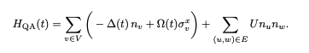
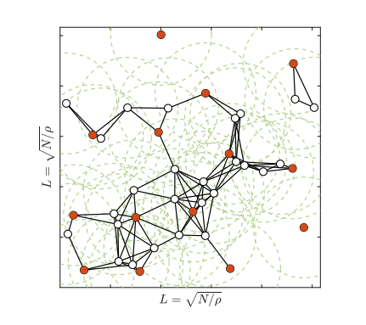
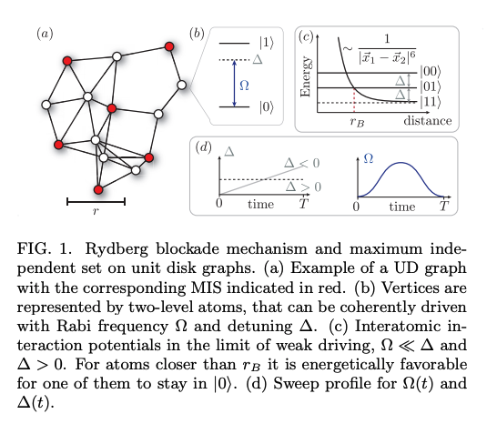
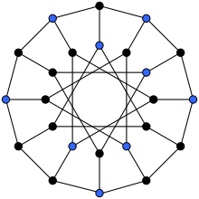


Rydberg System & MIS problem
Can be used to calculate maximum independent set!
Independent set (blue)
arXiv: 1808.10816

Slide 20
Bloqade: The Rydberg SDK
Built-in Waveform
Flexible, intuitive waveform with various filters
Flexible Built-in Lattices
with fancy visualization
Unit Handling
Built-in support for auto-unit conversion for QuEra Rydberg device
Integrate with Yao
Rydberg Hamiltonian
Symbolic Expression Contains all system information
CUDA acceleration
80x speedup at most
ODE solvers
generic, fast, and highly configurable ODE solvers from DiffEq community
Krylov Solvers
fast and generic Krylov solver
enable easy access to common quantum information processing functions
Notes:
Rydberg Hamiltonian
Waveform
Lattice
Unit Handling
ODE/Krylov
CUDA
Yao
Introduce Yao

Slide 21

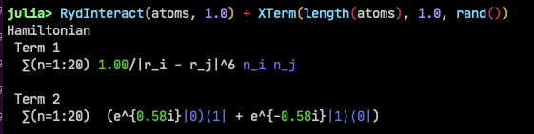

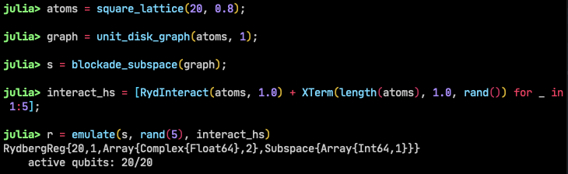
High performance and accurate emulation for Rydberg system
Automatic differentiation
DiffEq.jl
Symbolic Hamiltonian Expression
Blockade-
approximated emulation
over 300x speed up using CUDA
over 2000x speed up comparing to
open-source emulators
MIS experiment emulation (7x7 system)
QAOA emulation
200 days
0.5 days
See also: JuliaCon 2021 QuEra Computing Inc Sponsor Talk
Quantum optimization of maximum independent set using
Rydberg atom arrays, 10.1126/science.abo6587

Slide 22
Cloud service wrappers & frontends
Schema validation
REST API connection
Frontend wrapper
IBMQClient
AWSBraket (experimental)
OpenQASM
BloqadeSchema (QuEra machine with Braket)

Slide 23



Summer of Code
QuDiffEq (2019 JSoC)
OMEinsum (2019 GSoC)
ZXCalculus (2020 GSoC)
BQCESubroutine (2021 OSPP)
Yardstiq (2020 QOSF mentorship plan)
MAGMA wrapper (2019 JSoC)
Julia Summer of Code
Open Source Promotion Plan
QOSF mentorship plan

Slide 24
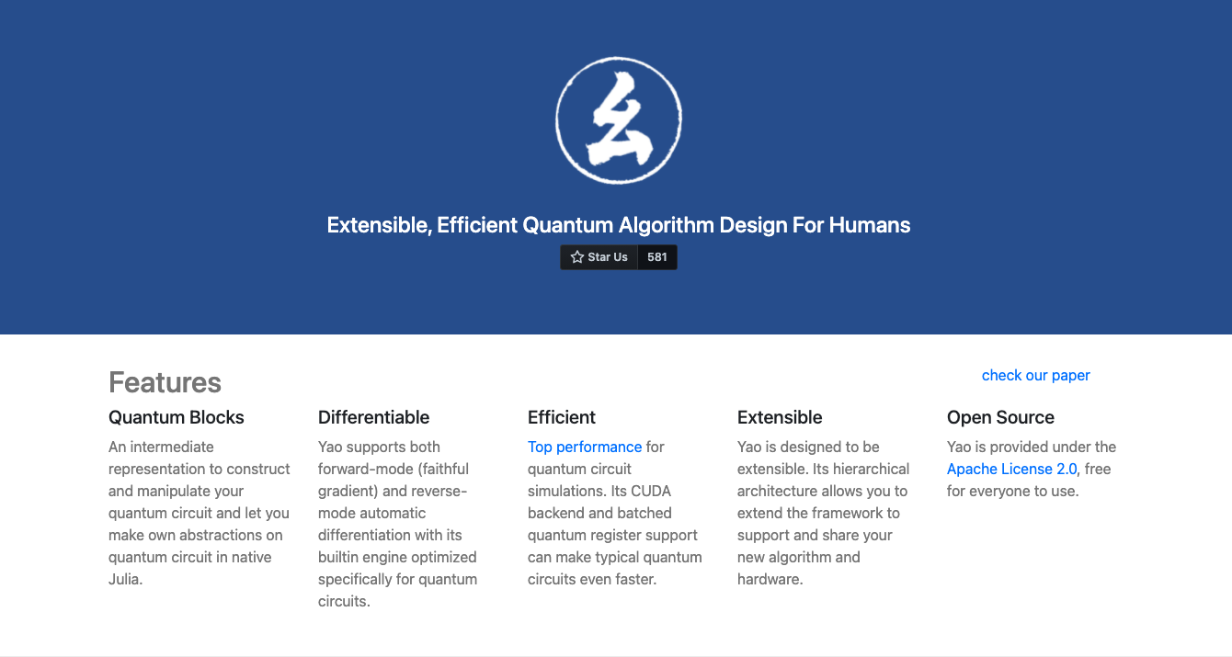
Thank you
yaoquantum.org

Slide 25
Problems
Yao’s current design of quantum circuit “block”s is not friendly to hybrid programs, e.g generate quantum circuit by probability

Slide 26
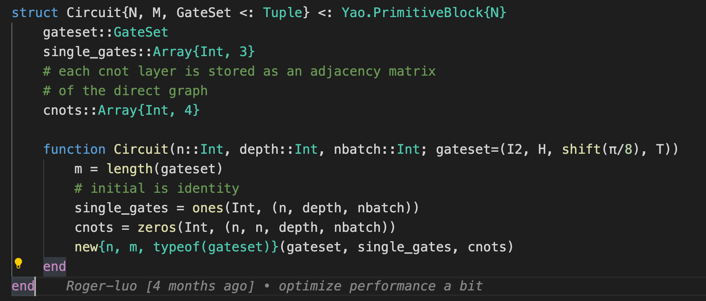
In YaoBlocks
arXiv: 1907.13022

Slide 27
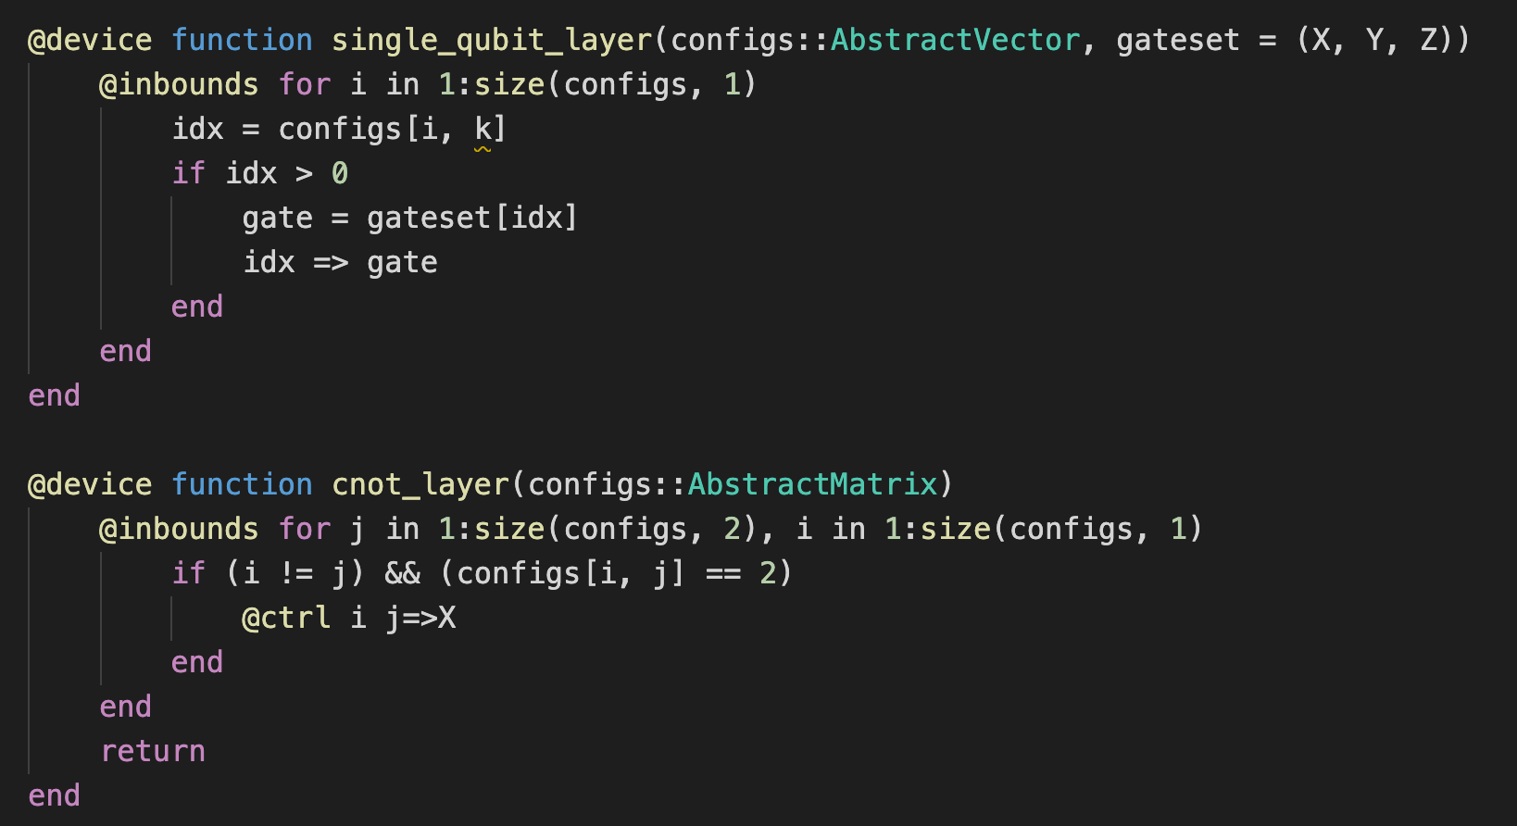
In YaoLang

